Slide 1
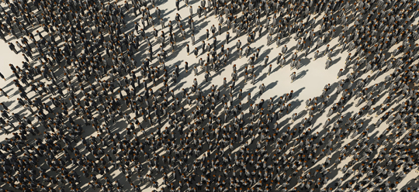
Inequality by Demographic Factors
Findings from Individual-Level Cantonal Tax Data
The Evolution of Economic and Social Inequalities in Switzerland (and Beyond): International Conference, Switzerland
Oliver Hümbelin und Rudolf Farys

Slide 2
Introduction
Income inequality is often understood as a result of unequal wages (economic factor) and redistribution (institutional factor). But research on the role of demographic factors is increasingly gaining attention.
(1) Von Weizsäcker (1996) argues that ageing of society affects income inequality. It should increase when inequality among retired is higher than among workforce (Grabka and Kuhn, 2012).
(2) Change in the «way of people living together» affects inequality. People marry later and divorce more often, which results in an increase of single-earner-HH and therefore increases income inequality (Peichl et. al, 2011; Daly and Valetta, 2006).
Research Question: Is Income inequality affected by demographic change, when looking at age groups and household types?
Notes:
Several demograpic trends can be connected to income inequaltiy

Slide 3
Data
Statistical «case studies» with individual cantonal Tax Data
Individual cantonal Tax Data which are collected as part of the SNF-Project (http://inequalities.ch/)
Tax data is administrative data, which means it’s a process generated, non-reactive data source (Diekman 2009:653)
Nice, because data coverage is good (full sample, no sample bias)
Basel-City
Urban canton
German speaking
Time period: 1991-2011
Income measure:
Net income (Reineinkommen)
+ Income from labor
+ Income from property
+ Direct social transfers
- Deductions, but no social deductions
Notes:
Regionalporträts der Kantone
http://www.bfs.admin.ch/bfs/portal/de/index/regionen/kantone/bs/key.html
Bei der Auswahl der Kantone haben wir zum Ziel möglichst lange Entwicklungsperioden abzudecken.

Slide 4
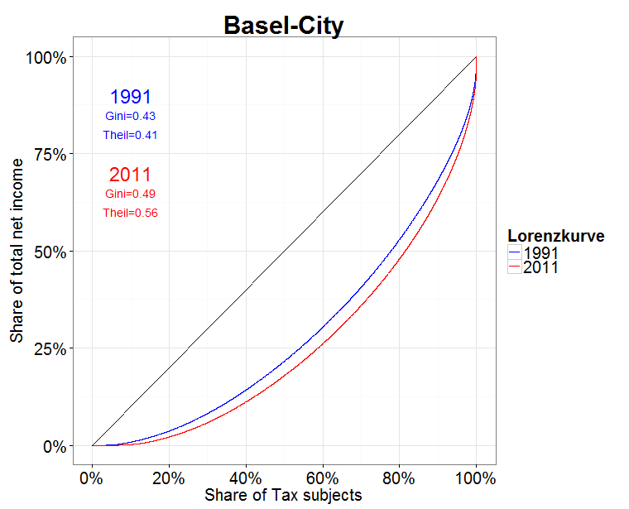
Results
Rise in overall inequality in Basel-City
Is rise of inequality affected by demographic factors?
Changes are possible due to
(a) Changing shares (e.g. poor group got bigger)
(b) Groups diverge (mean of subgroups differ stronger)
(c) Changing within subgroup inequality (e.g. something non demographic happened)

Slide 5

Method
Decomposing Overall inequality into within and between group components (Hao & Naiman 2010)
Theil-Index, an inequality measure developed from information theory (General Entropy class), is additively decomposable (Gini is not). Theil can be expressed as the between-group inequality plus the weighted sum of the inequality within each group
T$(y;θ\text{)}=\sum_{l=1}^{L}{∅^{l}{\left(\frac{μ^{l}}{μ}\right)}^{θ}T\left(y^{l};θ\right)+T(μ^{1},…,μ^{l},…μ^{L};}θ$)
By decomposing the Theil-Index we partitioned the total income inequality into between-group inequality (e.g. between age groups and household types) and within-group inequality. Hence we see, how the differences between and within each group contribute to overall inequality
Population-weights
within
between
Notes:
Remarks - you get between group inequality by assigning the group mean to every group member and the calculate the inequaltiy meassure
- The within group inequality indices are weighted with the adjusted group proportion > with large groups the weights seem to sum to 1. Adjustment is important for small sample size

Slide 6
Results
Age groups - Share of age groups and change over time
Three age groups
-25: young adults (education is important)
26 – 65: working population (wages)
65>: Retired (pensions)
Notes:
Compared to other cantons, in Basel-City we can find an overrepresentation of retired

Slide 7
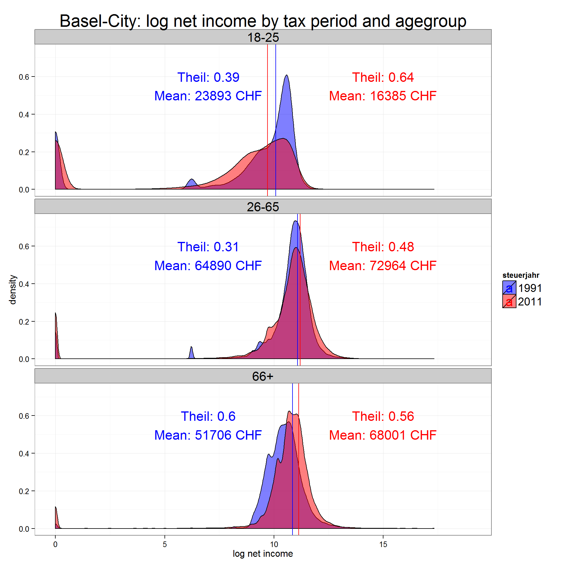
Results
Age groups - Between and within group inequality
On average young adults lost, while workforce and especially retired gained
But: Inequality within workforce and especially among young adults increased
Notes:
Junge Erwachsene sind heute länger in Ausbildung > verdienen weniger, Einkommen sind heterogener
- Vergleiche über die Zeit und zwischen den Gruppen

Slide 8
Results
Age groups - Contribution of within and between inequality to overall inequality
Inequality among Workforce (26-65) contributes most to overall inequality (big group) and relevance of inequality within this age group is rising.
Small increase of between-group component is because young adults “lost” relatively

Slide 9
Results
Households - Share of Household types and change over time
Global trend is reflected in cantonal data: decline of married and rise of single households
Notes:
Muss man sich noch überlegen, wie das genau dargestellt werden soll
Contribution to overall Inequality rausnehmen
Der Überschuss bei den Single Women lässt sich vor allem durch Witwen erklären > Männer sterben früher als Frauen.

Slide 10
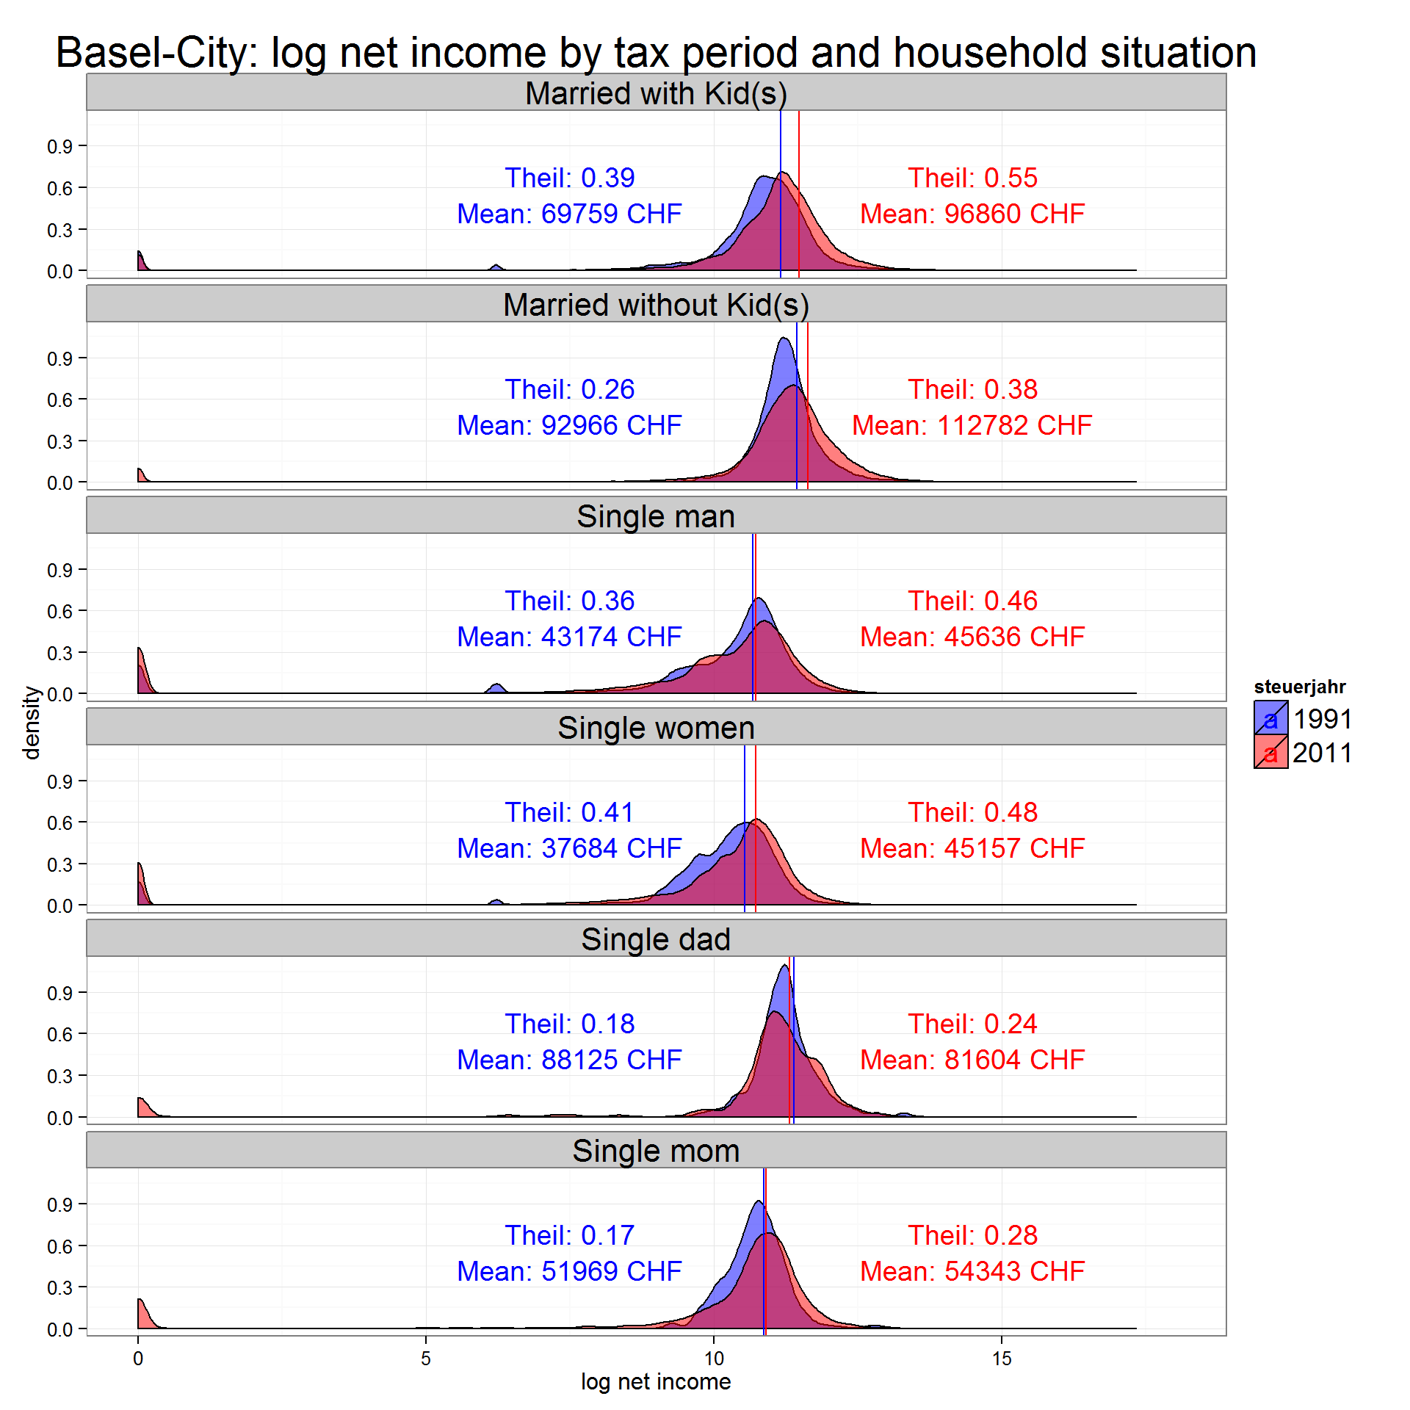
Results
Households- Between and within inequality
Between group differences are high between married and single
married HH gained more on average (pronunciation of between group differences)
But: Inequality reaches a maximum at a single-share of about 60%
Notes:
Grafiken unter dem Aspekt von Lebenszyklus und Haushaltsbildung besprechen:
married without kids bspw. > junge Paare und Personen im späten Erwerbsalter (Kinder bereits ausgezogen).

Slide 11
Results
Households - Contribution of within and between inequality to overall inequality
Between group differences are high between married and single
married HH gained more on average (pronunciation of between group differences)
But: Inequality reaches a maximum at a single-share of about 60%
Notes:
Grafiken unter dem Aspekt von Lebenszyklus und Haushaltsbildung besprechen:
married without kids bspw. > junge Paare und Personen im späten Erwerbsalter (Kinder bereits ausgezogen).

Slide 12
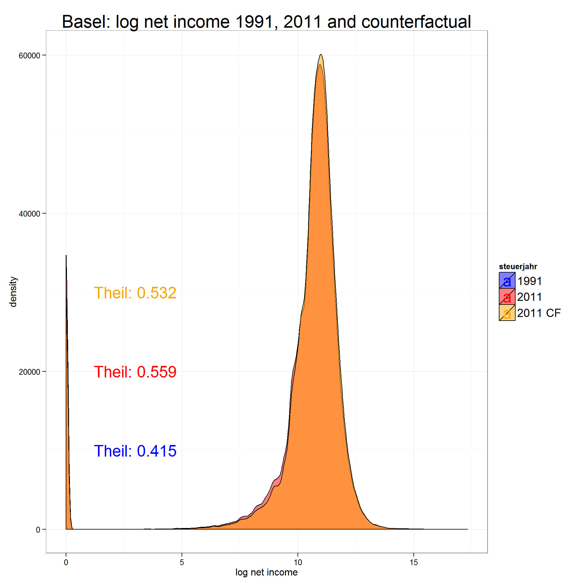
Counterfactual Distribution – How would inequality look like, if demographic structure wouldn't have changed?
Method
Weighting of 2011 distribution with 1991 weights calculated with inverse probability weighting
Result
Inequality would be smaller
19% of rise of inequality is due to change in demographic variables (age, household)
Notes:
12

Slide 13
Conclusion
Von Weizsäcker (1996) assumes that ageing of society leads to higher income inequality
→ Indeed, inequality rose for working people and decreased for retired while
median incomes rose for retired people only
→ Overall inequality is strongly affected (61%) by inequality within workforce (25-65). Rising Trend.
→ Ageing of society is associated with increase of inequality
Rise in inequality in the US due to more people living alone (Daly/Valetta (2006)
→ People indeed live less and less in married households
→ Contribution of within single inequality and importance of between component to overall inequality did rise
→ does a „single“ equal a single household? Further analyses with Bern data
Notes:
13

